Slide 1
What is GitHub and why should I use it?

Slide 2


Richard Fennell
Chief Technology Officer (CTO)
MVP (Developer Technologies)
@RichardFennell

Slide 3






Notes:
Developed in 2005 by Linus Torvalds, the famous creator of the Linux operating system kernel.
You can host your own copy
But there are providers who offer more

Slide 4



Figures from October 2021
Notes:
Self hosted can be on your tin or in the cloud

Slide 5

GitHub is more than just source control

Slide 6

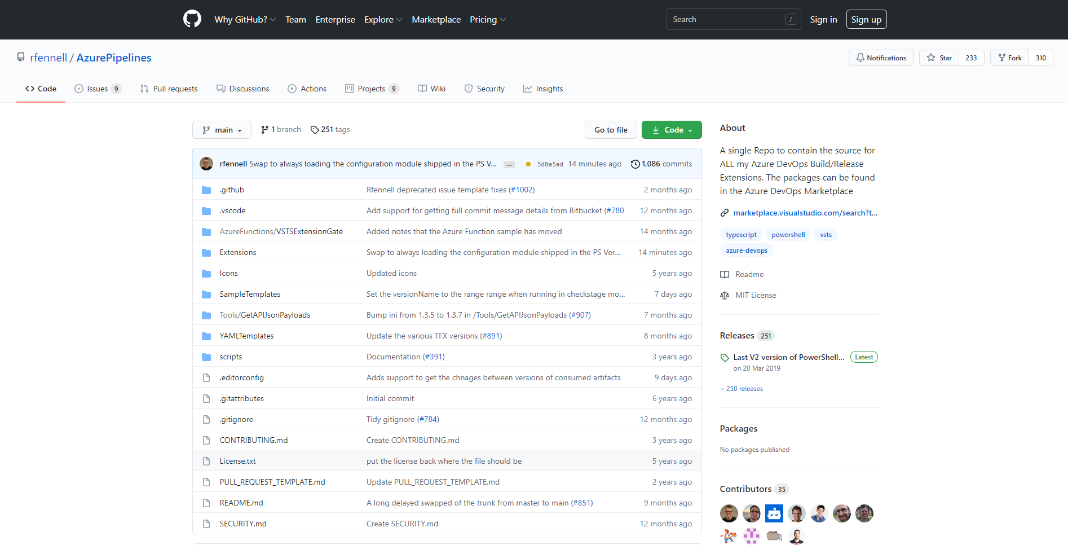
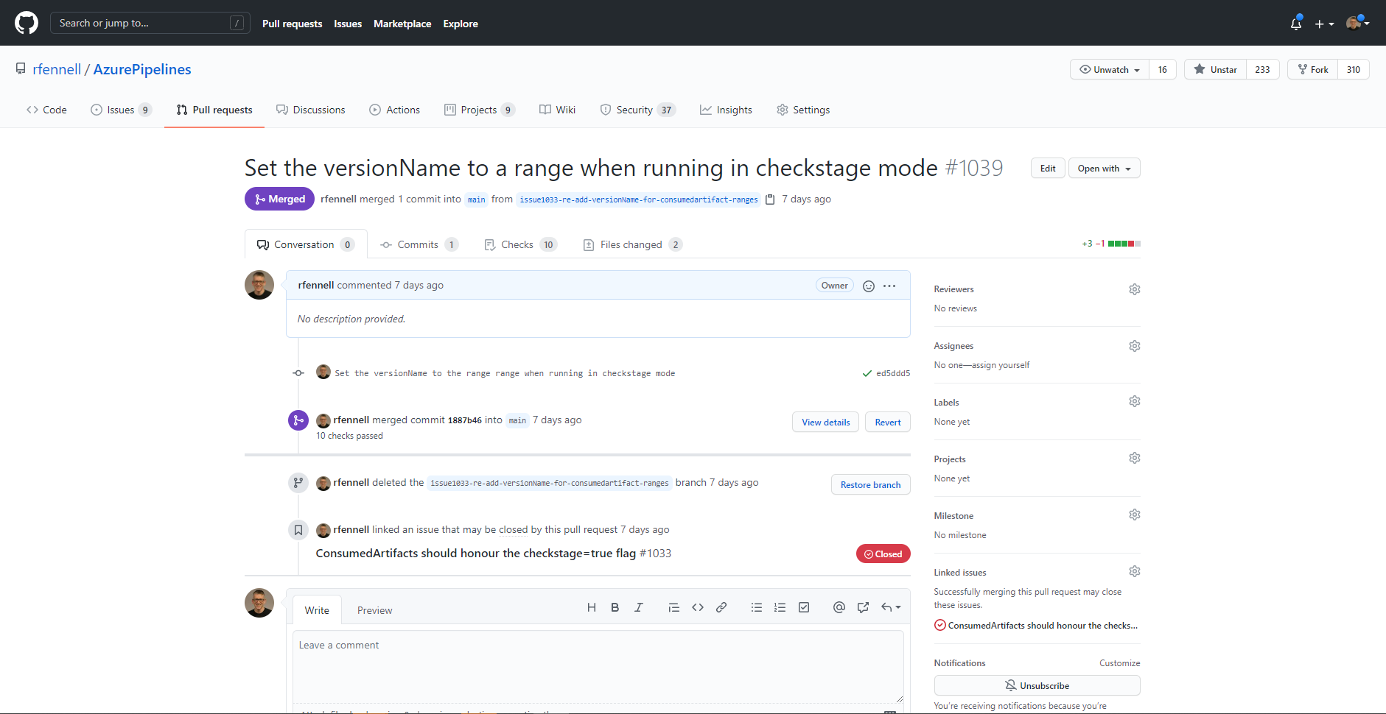
GitHub Features
Code
Git based source control
Supports all languages and platforms
Extended with Pull Requests

Slide 7
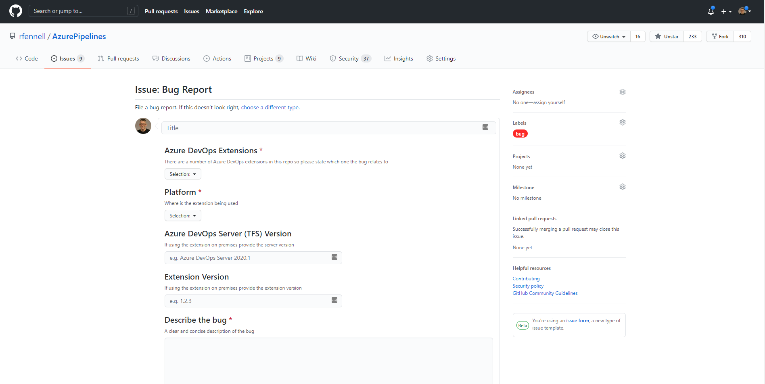
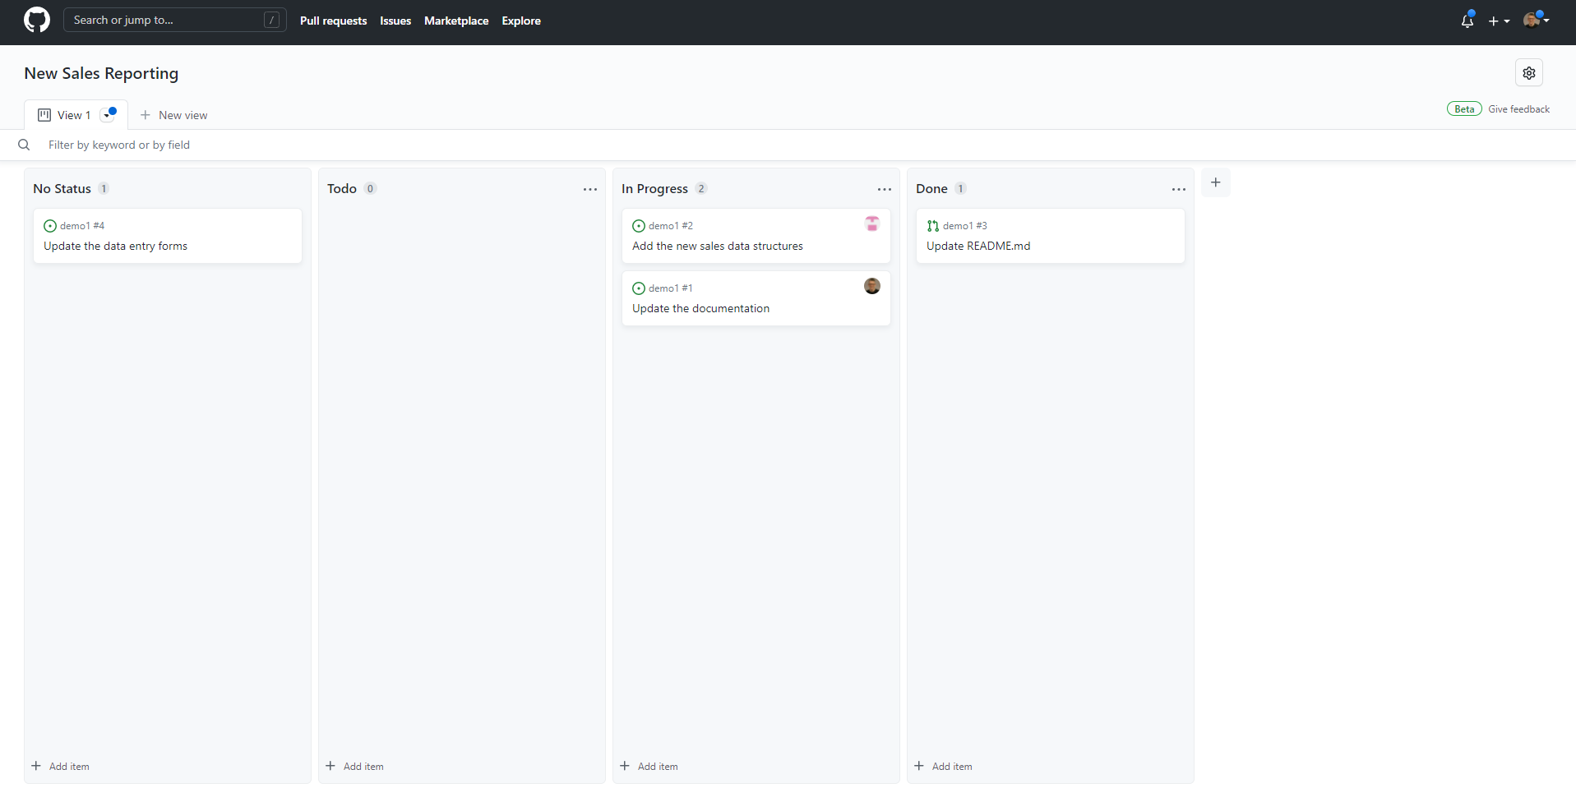
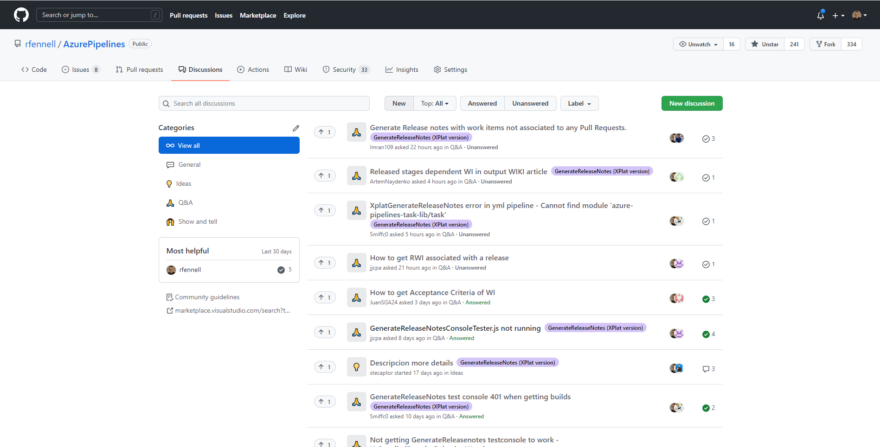
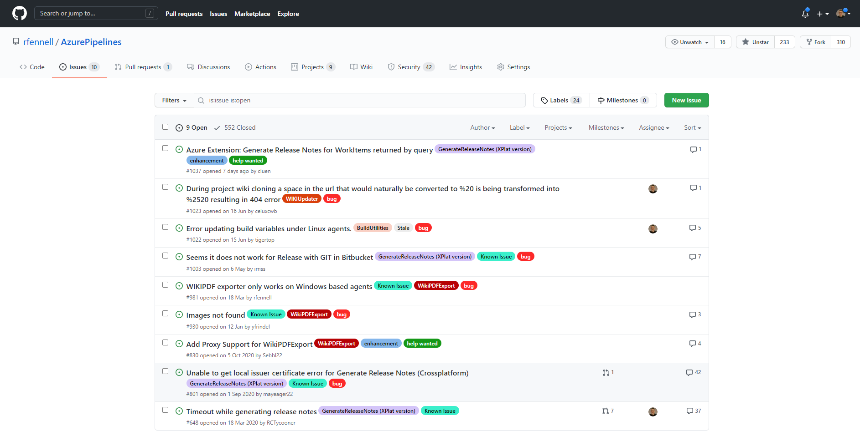
GitHub Features
Issue
Simple conversation-based threads
Beta - Forms Based Issues
Beta – Projects (Memex)
Beta – Discussions

Slide 8
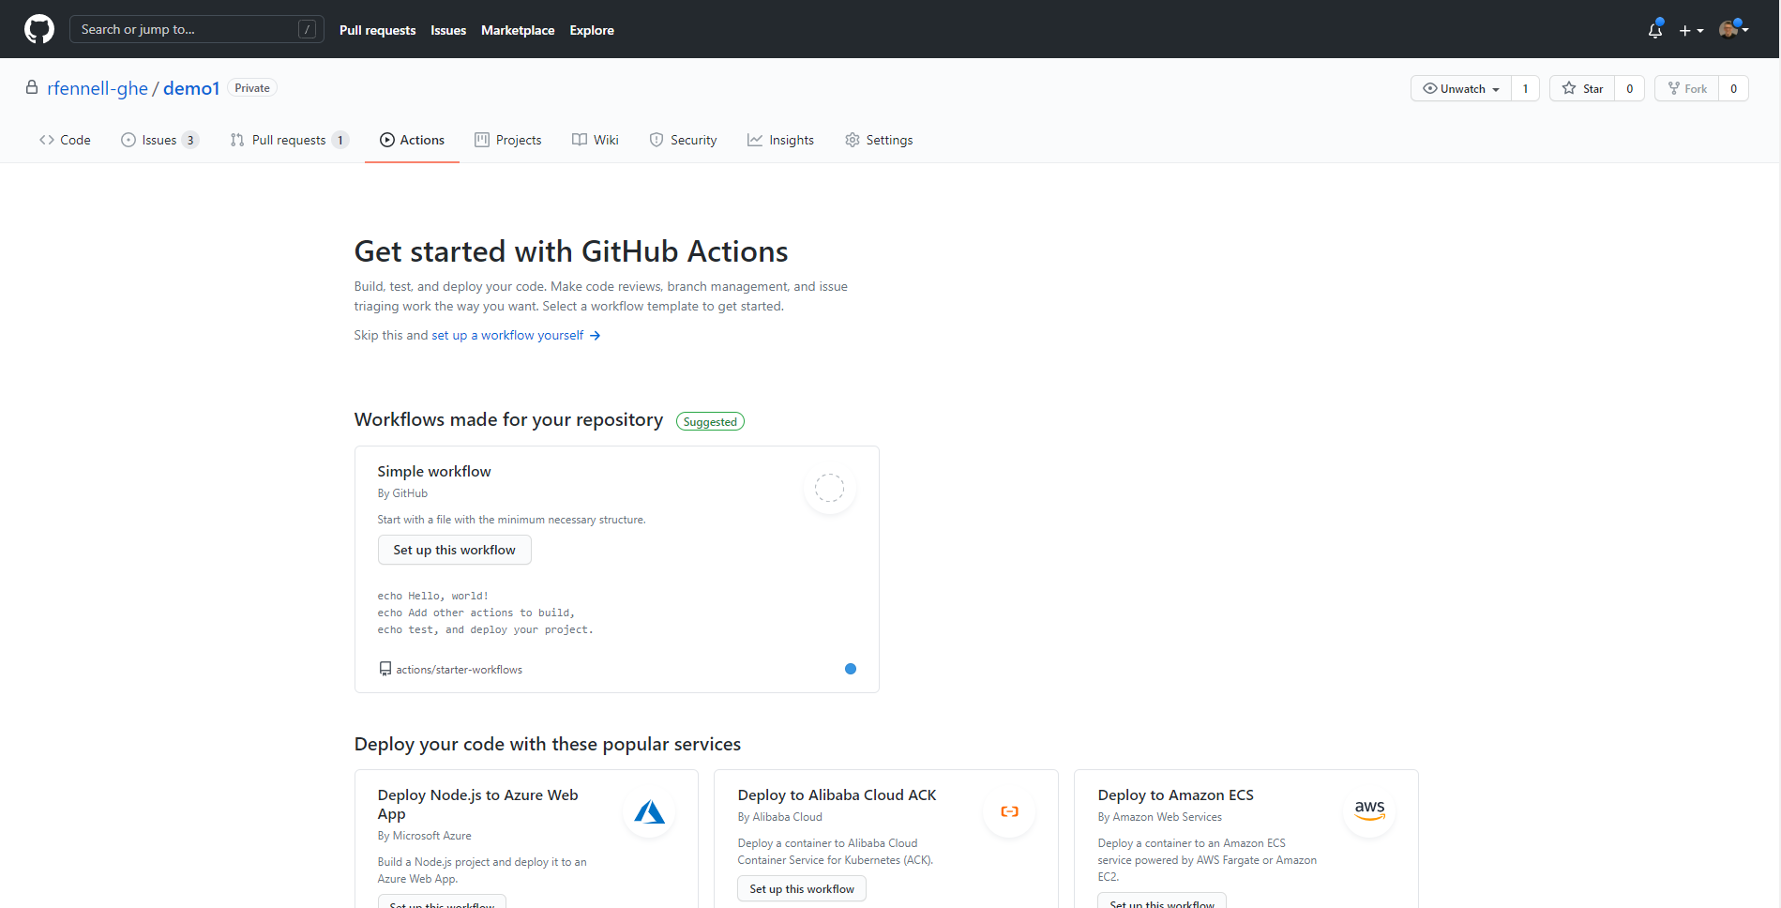
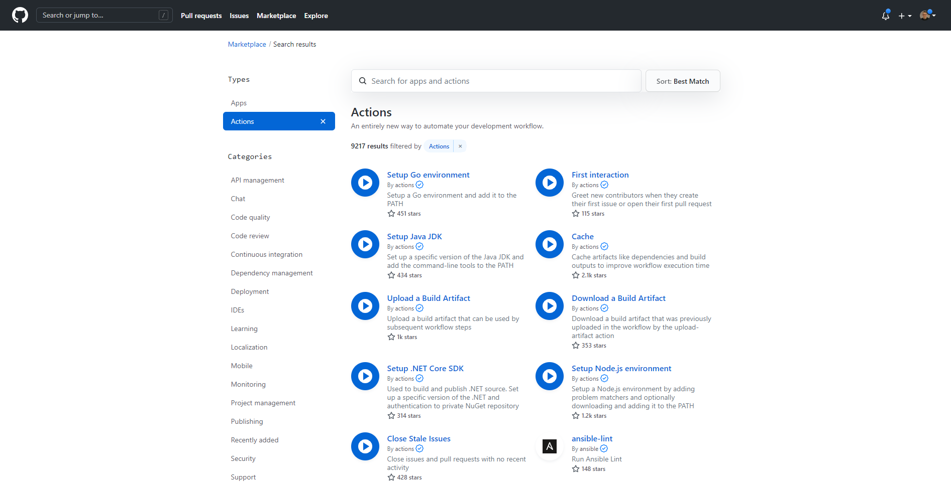
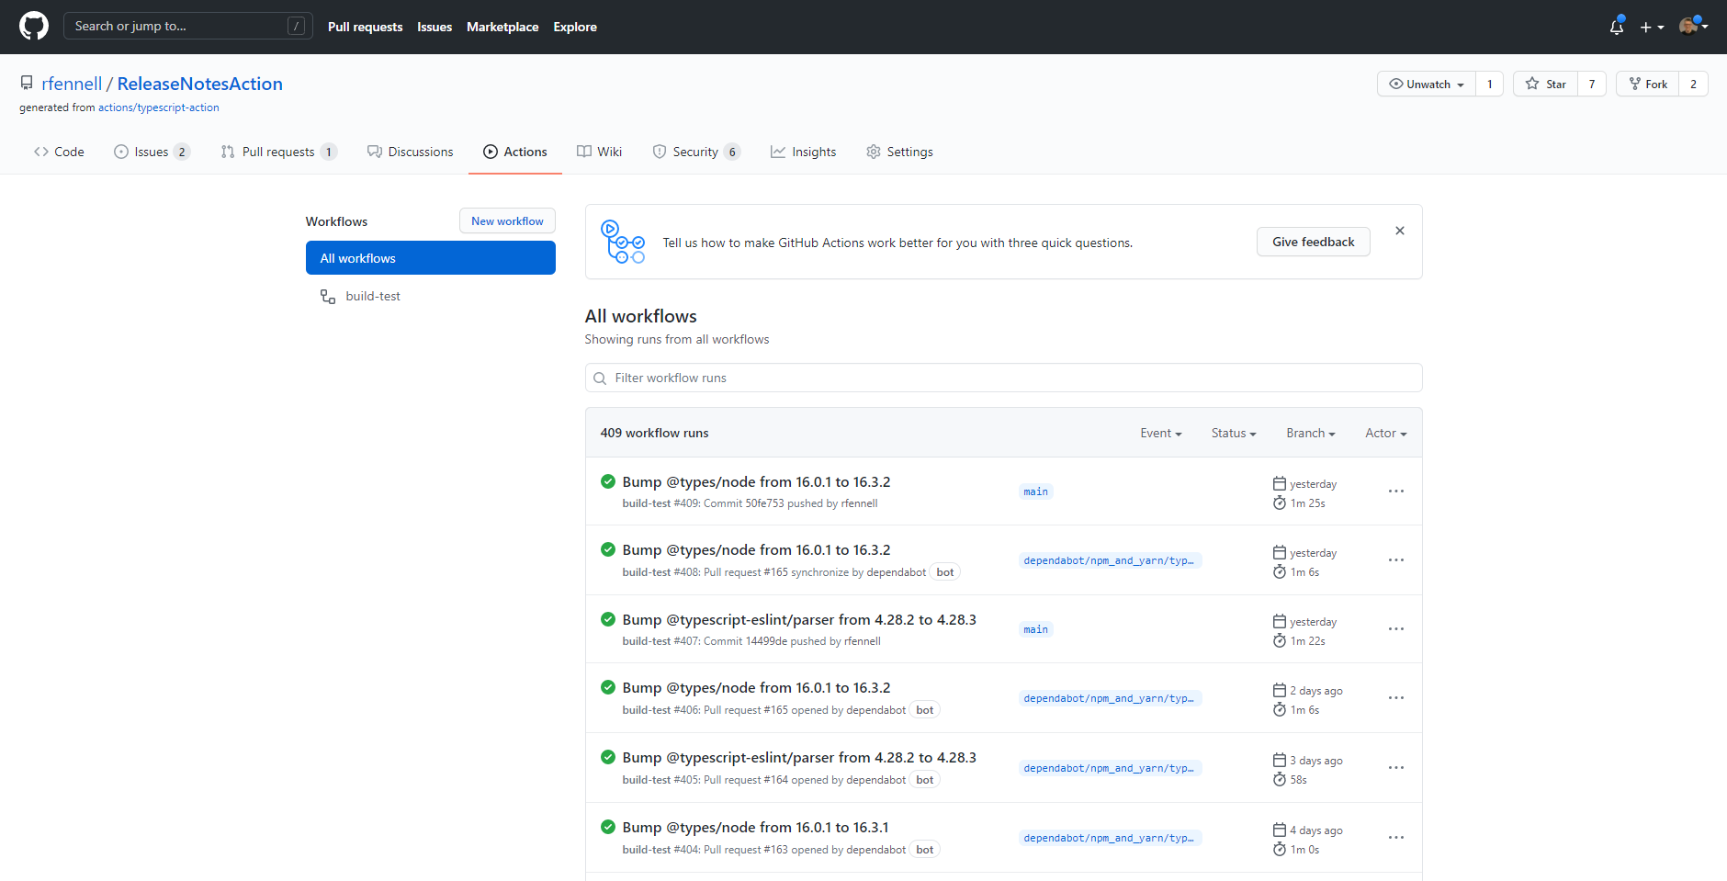
GitHub Features
Actions
Build any language any platform
Quick start Samples
Marketplace of Actions

Slide 9
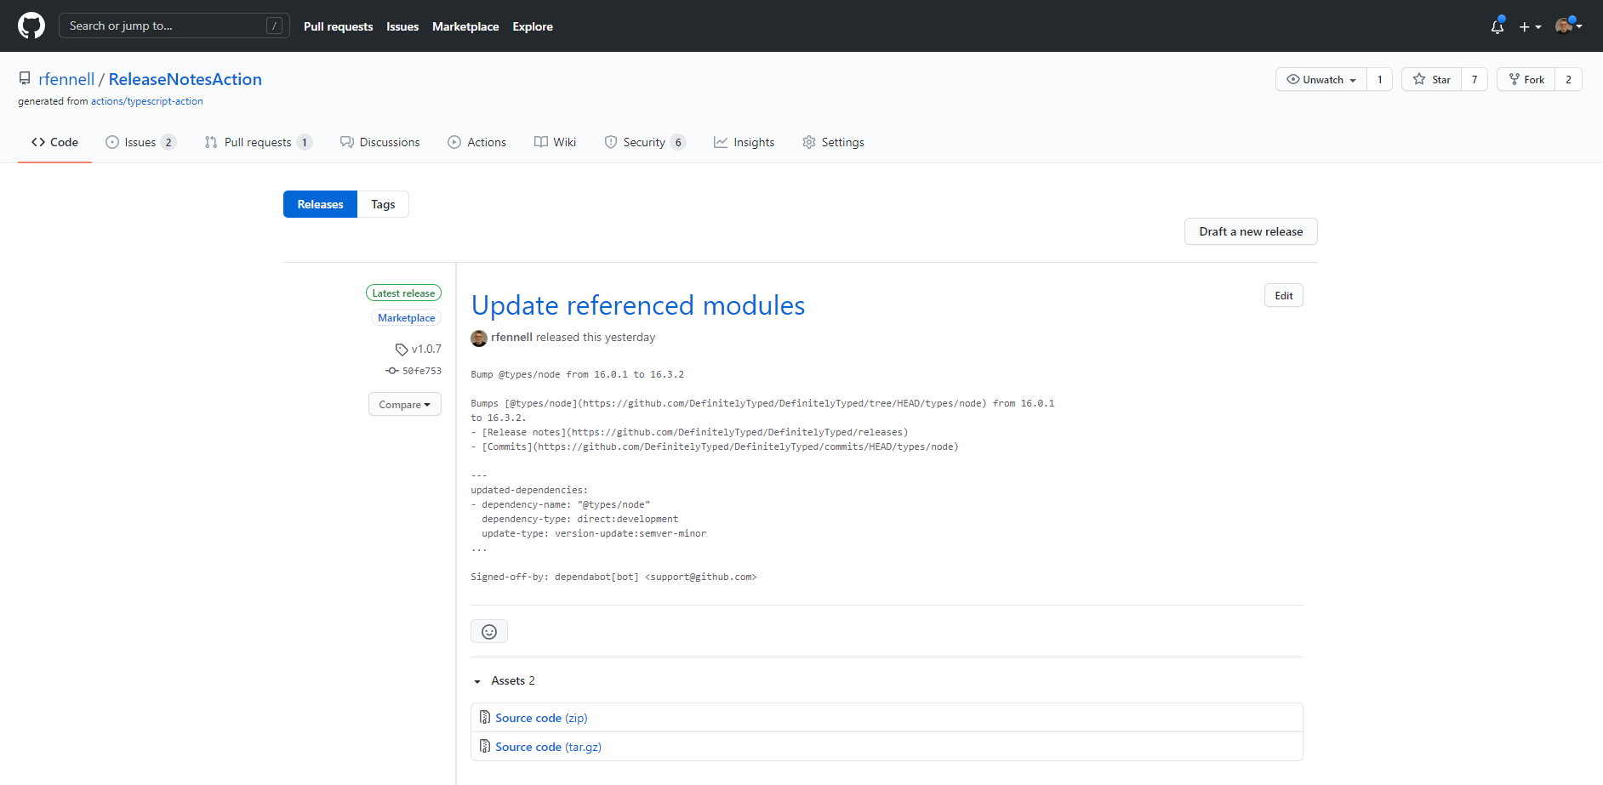
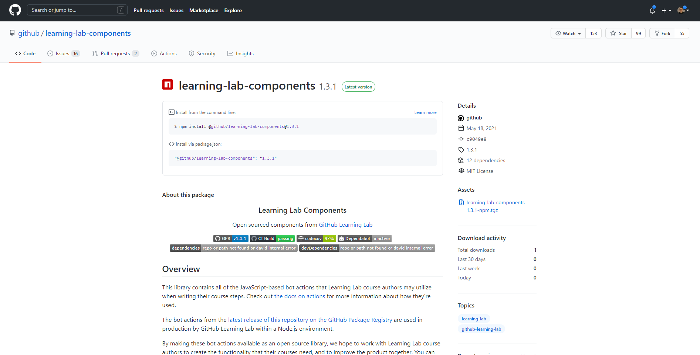
GitHub Features
Release and Packages
Releases of Source code Snapshots
Package Management Feeds

Slide 10
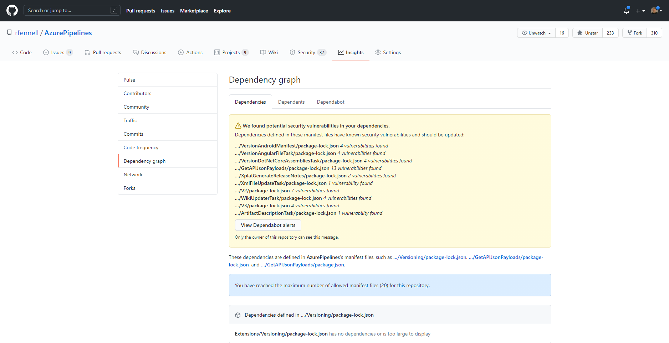
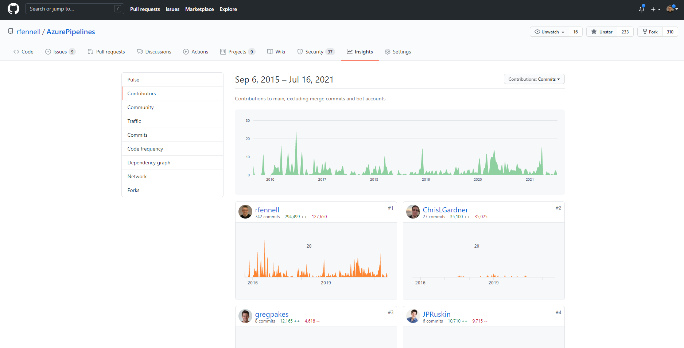
GitHub Features
Insights
Reporting
DependaBot

Slide 11
Are there different versions of GitHub?

Slide 12
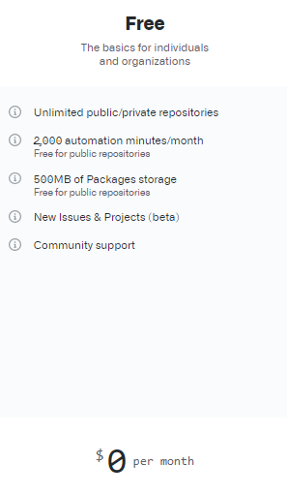
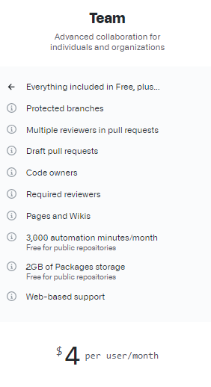
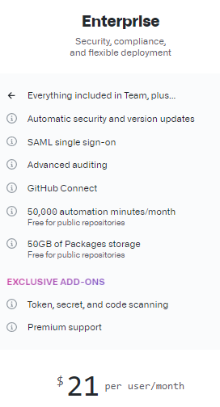

Notes:
GitHub
Free
Team - $4
Enterprise - $21
GitHub One – ask
Can you VS MSDN + GitHub Enterprise

Slide 13

https://education.github.com/students

Slide 14
Demo
Notes:
Show create create, work down the form
Discuss new/import/template/fork
Scope of a repo – a project
Public/Private
Standard files
Could import a sample with code from rfennell/demorepo, or have pre created, swap to it
Code
Mention branches and history
Issues
Add an issue to add a build
Note can assign, label, project to group
PR come back to them
Actions
Add a CI action – show it list sample
Pick manual and drop in sample code, and discuss, commit to a new branch
PR
Discuss PR
Show it run the build
Can set rules for a PR – this is the best tool to improve quality even if you one person
Discuss merge policies
Shows Projects, WIKI and Insights in another repo
Mention forks
Dependabot
This has all been in the browser, but normally edit on your machine
Clone
Codespaces (30sec to start)

Slide 15

Summary
GitHub provides a complete ALM solution
You can easily collaborate with others
GitHub is free for student usage scenarios
So why not give it a try?

Slide 16
Questions?

Slide 17














Azure Integration Services

Slide 18





blogs.blackmarble.co.uk
+44 (0)1274 300175
@blackmarble
Black Marble Ltd.
Black Marble

